Slide 1
Human Presence and Activity Detection from WiFi CSI Data using CNN
Md Touhiduzzaman
Samah Ahmad
Maher Al Islam

Slide 2
Outline
WiFi Sensing
Problem Statement
Dataset
Our Approach
Results
Future Scopes
Conclusion

Slide 3
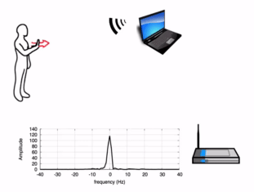
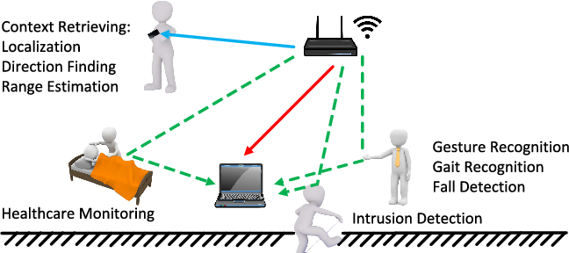
1. WiFi Sensing
What?
A combination of Wi-Fi and RADAR sensing technology
Use of the same Wi-Fi transceiver hardware and RF spectrum
Physical layer in RADAR systems
Well-defined MAC layer for WiFi sensing
More Complex Algorithms than in RADAR like FFT, OFDM processing etc.
Both Communication and Gesture Detection
Biometric measurements (e.g. breathing^{[1][2]})
[1] https://wballiance.com/resource/wi-fi-sensing/
[2] Wi-Fi Sensing: Revolutionizing Motion Sensing with Wi-Fi technology. Semiconductor Components Industries LLC. July 2020.
Notes:
- fine tuned to detect so subtle changes in the environment like breathing
- that shows the depth of the capability of WiFi sensing

Slide 4
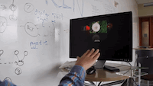


1. WiFi Sensing
Examples^{[3]}
Controlling Slideshow
Controlling TV From Anywhere
Smart Home Applications
[3] http://wisee.cs.washington.edu/
Notes:
* WiSee - Uni. of Washington
* 1st - a person is controlling a slideshow using his wrist movement
* middle - a TV remote alternative is shown using WiFi sensing
* 3rd example - we can turn the lights of the whole apartment on or off using WiFi sensing & smart home appliances as well

Slide 5
1. WiFi Sensing
Why?
More Privacy Safety
Ubiquitous Gestures than Line of Sight for Cameras
Less Data Volume to Store in Comparison to Video/Image Data
Cheaper & Available Hardware
Whole Body Gestures
Larger Combination of Events
Notes:
Why would someone use WiFi Sensing whereas we have easy to use libraries like OpenCV and other gesture recog. Systems?
- example: Monitoring a patient in a hospital bed
– doing good or in trouble
- huge data volume 24/7
- so costly &
- more computation time to process & learn
- if our patient falls inside the washroom, we cannot monitor there by the camera
* If use WiFi sensing :
- so ubiquitous, no need of being in the Line of Sight
- textual CSI/RSS data
– can ensure privacy more &
- Combination of Events using broader area

Slide 6
2. Problem Statement
a_{i} = ?
where, a_{i} ∈ A = {a₁, a₂, a₃, ..., a₁₂} in an environment e_{i} ∈ E = {e₁, e₂, e₃} by a person s_{i} ∈ S = {s₁, s₂, s₃, ..., s₃₀} within a set of classes of actions C = {c₁, c₂, c₃, c₄, c₅}

Slide 7
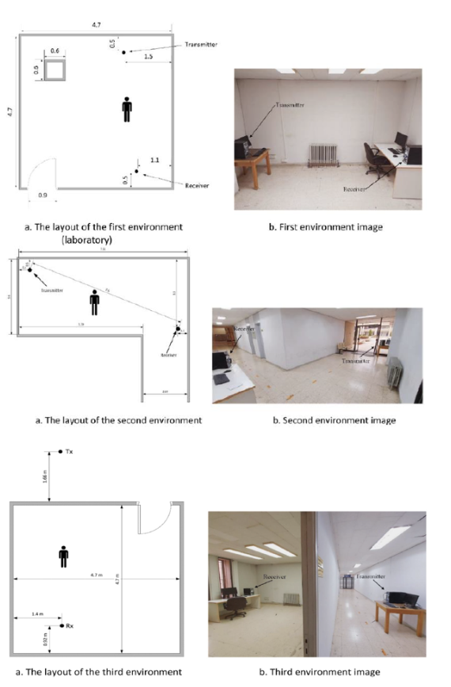
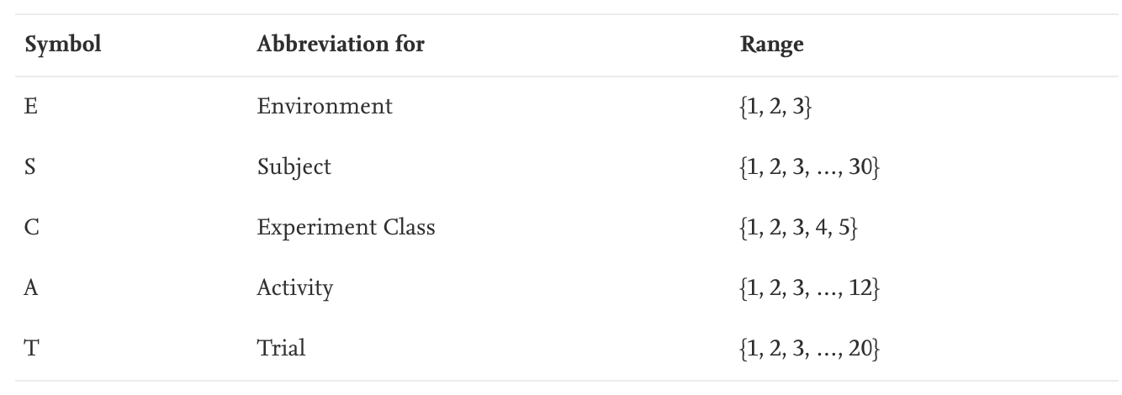
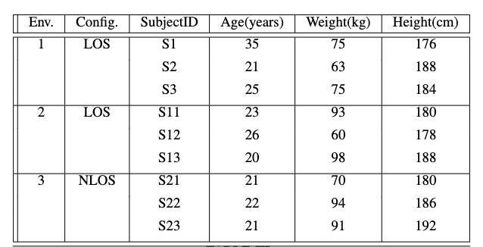
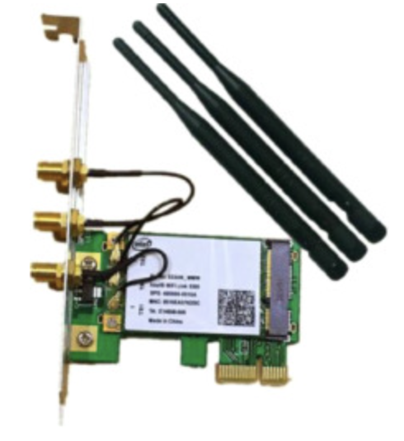
3. Dataset
Intel 5300 NIC as Access Point (AP)
3 Raspberry Pi connected with each AP as clients
AP with 3 Antennas
30 sub-carrier per NIC per antenna
Total Subcarriers = 3*30 = 90

Slide 8
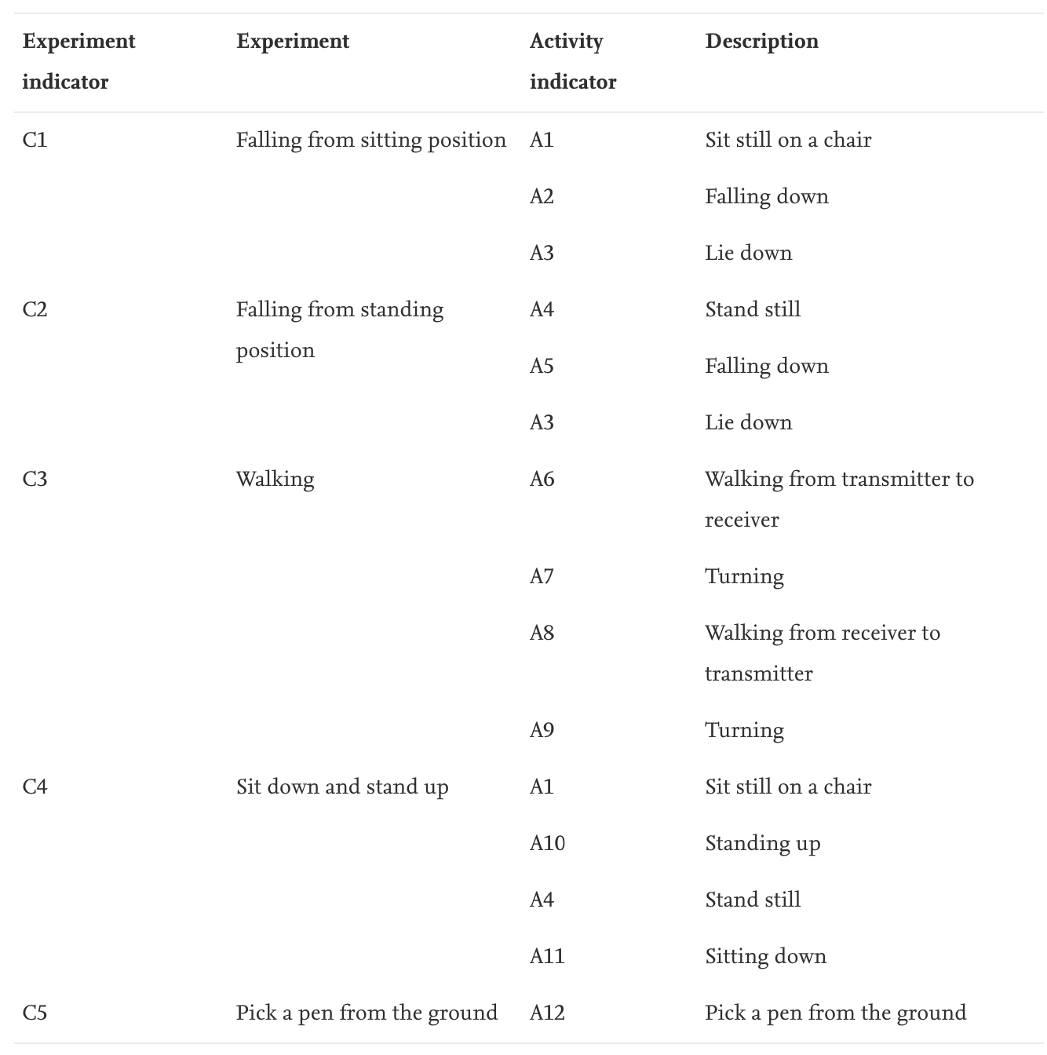
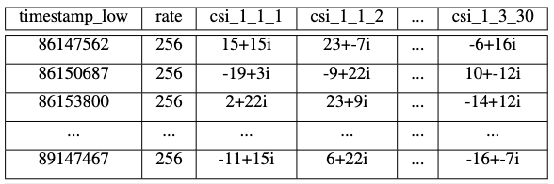
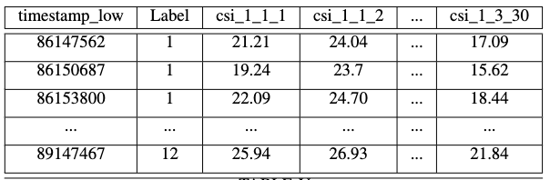
3. Dataset

Slide 9
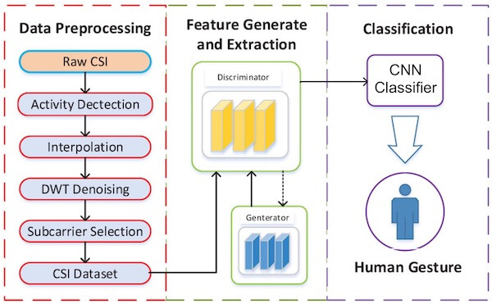
3. Dataset & Preprocessing

Slide 10
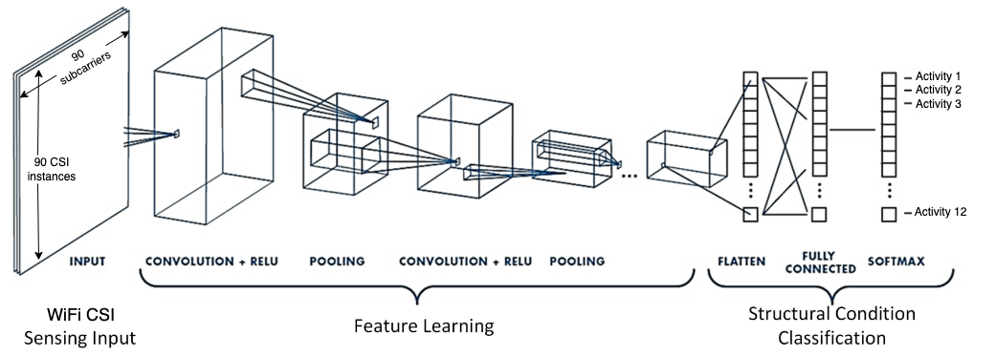
4. Our Approach

Slide 11
4. Our Approach
Constants:
Number of Layers:
2 Convolution
1 ReShape
1 Dense
Padding=0, Stride=1
Filter Numbers in latter layers:
2nd Layer = Twice of the 1st layer
3rd Layer = Reshaped same size as the 2nd layer
#Output of the 4th Layer = 12 * 256
#Output of the 4th Layer = 12
Variables:
Batch Size = {100, 256, 512, 1024, 1536, 2048}
Filter Size = {3x3, 5x5}
Pool Size = {2x2, 4x4}
#Filters = {5, 10, 15, 32, 64}

Slide 12
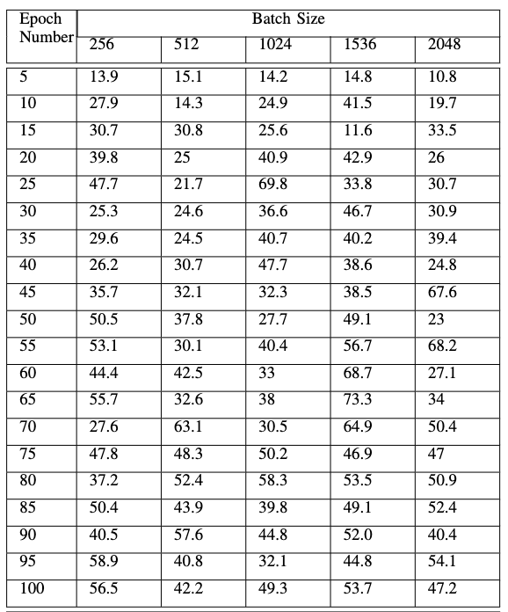
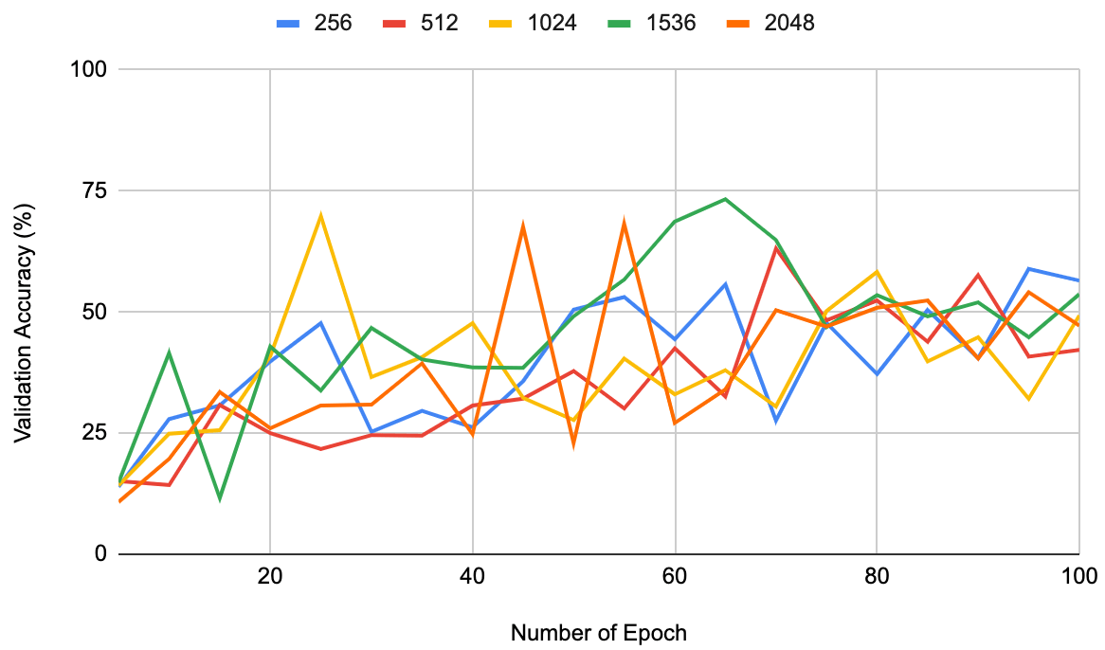
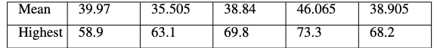
5. Results

Slide 13
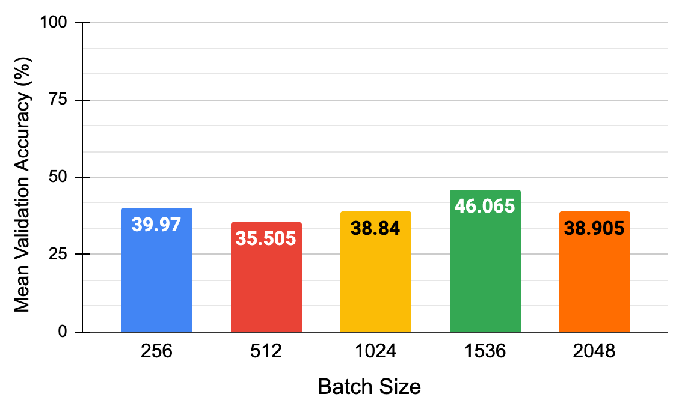
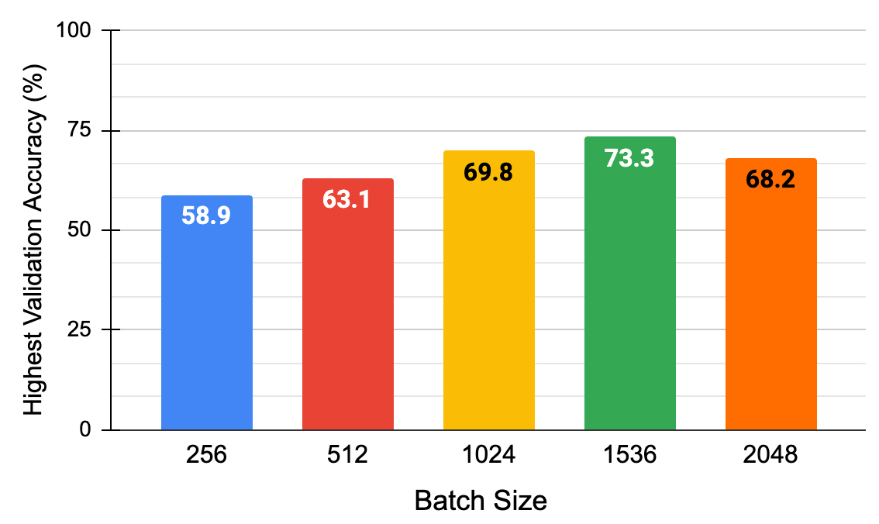
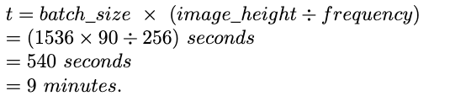
5. Results
* Batch Size is found to be the most significant variable , because this is a well-timed dataset and batch-size can be related to the duration of actions as:

Slide 14
6. Future Scopes
Variation of Layer Configurations
Variation of Activation Functions other than ReLU
More Variation of Filter & Pool Size
Application of Denoising Filters like DWT, Hampel, Butterworth, etc.
In the Same Dataset –
Predict the Class of the Action
Predict the Person doing the Action
Apply the Model to Other Available Datasets
Random actions may be challenging, as this dataset is a well-timed one.

Slide 15
7. Conclusion
Accuracy 73.3% at best
Alazrai et. al.^{[31]} achieves 69.78% accuracy with all the 12 actions of the same dataset
Alsaify et. al. ^{[32]} achieves 94% accuracy with just 6 actions from this dataset
Well-Timed Dataset, so Batch-Size is Important
Novelty in Application of CNN for such a varying dataset

Slide 16

Thank You!
Questions?
Notes:
- challenge: Reading the data file into memory - crashing program

